Slide 1







Testing your databases
Alessandro Alpi (@suxstellino)
Data Platform MVP since 2008
alessandro.alpi@engageitservices.it

Slide 2
Agenda
DevOps concepts
Unit Testing concepts
Why Unit Testing on databases
Unit Testing frameworks
Unit Testing solutions
Conclusions
Q&A

Slide 3

DevOps concept
DevOps is a culture, movement or practice that emphasizes the collaboration and communication of both software developers and other information-technology(IT) professionals while automating the process of software delivery and infrastructure changes. It aims at establishing a culture and environment where building, testing, and releasing software, can happen rapidly, frequently, and more reliably
(source Wikipedia)

Slide 4




We will speak about…
Development teams
We’re writing code and features
Preventing regressions
We’d like to avoid breaking changes for the customers
Reducing bugs
We’d like to avoid any time waste (on fixes)
Improving quality
We want to reach the best quality for our products

Slide 5
We want reach these goals
Involve QA teams
We want to get a team that works on Quality Assurance
Implement backward compatibility
We want to develop using refactoring patterns
Cover with unit tests
We could start writing tests, before implementing the feature
Quality with productivity
We can finally use tools and frameworks

Slide 6

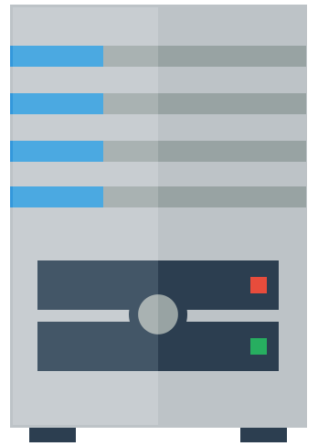

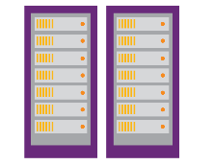




What we need to reach DevOps
IDE
Source Control Manager
(Version control system)
Build server and process
(also for automation)
QA / Unit test process
(automated)
Release processes
(automated and reliable)
Development
Operation
Integration

Slide 7
Unit Testing concept
In computer programming, unit testing is a software testing method by which individual units of source code, sets of one or more computer program modules together with associated control data, usage procedures, and operating procedures are tested to determine if they are fit for use. The primary purpose of this approach is to find out bugs and prevent regressions.
(source: Wikipedia)

Slide 8
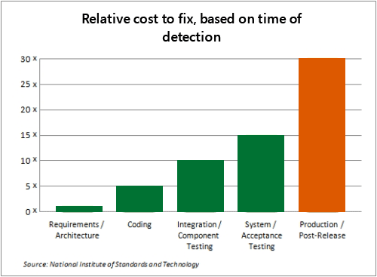
Unit testing – why?
Focus on Mission-critical capabs
Supporting evolutionary development
continuous improvement
Prevent regressions
Reduce the number of bugs
Reduce the development costs
for fixes

Slide 9
Best practice..
«Fix bugs as soon as you find them»
Unfixed bugs camouflage other bugs
Unfixed bugs suggest that “the quality isn’t important”
Discussing unfixed bugs is a waste of time
Unfixed bugs lead to duplicate effort

Slide 10
Lesson learnt
Unfixed bugs lead to unreliable metrics
Unfixed bugs distract the entire team
Unfixed bugs hinder short-notice releases
Unfixed bugs lead to inaccurate estimates
Fixing familiar code is easier
Fixing a bug today costs less than tomorrow

Slide 11
What we usually do when “testing”
Executing the code on a copy of production data
Manual testing
T-SQL debug for checking variable values
PRINT, PRINT, SELECT…
Not repeatable and human errors (subjectivity)
Some test cases forgotten as the code changes.
Some test is made on structures with “test-unrelated” constraints which could break the test itself

Slide 12
What we have to test on databases
Calculations in procedures and functions
Constraints (schema)
Edge cases of data DML
Expected behavior of data DML
Error Handling
Security
Standards (SQLCop)

Slide 13
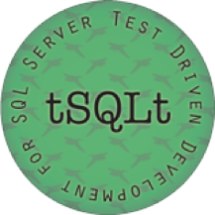
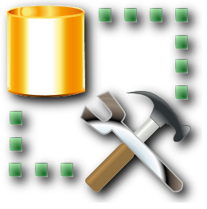
A possible solution
tSQLt (free)
Simple to install
Simple test schema (Assemble, Act, Assert)
Framework in t-sql
Can be installed as tool with Red Gate SQL Test (UI, not free)
SQL Server Management Studio
Using t-sql
Using Red Gate SQL Test (tsqlt, not free)
Integrated with SQLCop framework

Slide 14
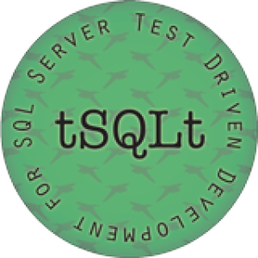
tSQLt – Structure
Built-in
tsqlt schema
Classes
Group of stored procedures (tests)
User defined schema
Conventions
Naming: test*
Tools
Run
NewTestClass/DropClass
Fail/Assert
Uninstall

Slide 15
tSQLt – Pipeline
Assemble
Act
Assert
Create fakes
Specify fakes options
Populate fakes
Execute commands
Apply biz logic
Execute proc or func
Expected values
Expected metadata
Expected behaviors

Slide 16
LET’S PLAY
tSQLt + SQL Server Management Studio

Slide 17
Conclusions
There is no excuse for NOT testing
like any other piece of code
Tools exist for testing
Tools exist for generating data
Testing processes really improve the quality
Allows us to respect the application business requirements

Slide 18
Questions?
..and, hopefully, answers!

Slide 19
THANK YOU!

Slide 20
Resources
http://www.red-gate.com/products/sql-development/sql-test/
http://tsqlt.org/
http://sourceforge.net/projects/tsqlunit/
http://msdn.microsoft.com/en-us/library/dd172118(v=vs.100).aspx (VS 2010)
http://blogs.msdn.com/b/ssdt/archive/2012/12/07/getting-started-with-sql-server-database-unit-testing-in-ssdt.aspx (SSDT)
http://msdn.microsoft.com/en-us/library/jj851200(v=vs.103).aspx (VS 2012)
http://channel9.msdn.com/Events/Visual-Studio/Launch-2013/QE107 (VS 2013)
http://msdn.microsoft.com/it-it/library/dn383992.aspx (Article on CI)
http://msdn.microsoft.com/en-us/library/jj907294.aspx (DLM)
http://en.wikipedia.org/wiki/Unit_testing
https://www.simple-talk.com/sql/t-sql-programming/getting-started-testing-databases-with-tsqlt/
http://utplsql.sourceforge.net/ (PL-SQL)
https://github.com/chrisoldwood/SS-Unit

Slide 21






My work
SQL Server sotto source control
Unit testing con SQL Server
SQL Server Continuous Integration
Virtual chapter su SQL Server e source control
getlatestversion
ALM su getlatestversion.it
Putting our database under source control
Unit testing on SQL Server databases with tSQLt
ALM on docs.com

Slide 22
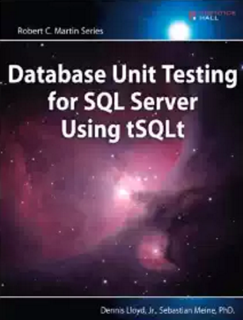
Books
Database unit testing for SQL Server using tSQLt

Slide 23
Grazie agli sponsor

